Slide 1
CONTROL UNIT

Slide 2
Introduction
CPU is viewed as a collection of two major components:
Processing section
Control Unit
Control unit’s responsibility is to drive the associated processing HW by generating a set of signals that are synchronized with the master clock.
In order to carry out a task, the CU must generate a set of control signals in a predefined sequence governed by the HW struct of the processing section.

Slide 3
Introduction (Contd..)
Inputs to CU are:
Master clock
Status info from processing section
Command signals from external agent (like RESET, ABORT)
Outputs produced by CU
Signals that drive the processing section and responses to an external environment.
Control unit undertakes the following responsibilities:
Instruction interpretation: ( CU read instr. , recognizes the instr type, gets operands and route to appropriate functional units of EU, necessary control signals are then issued to the EU to perform desired operation)
Instruction sequencing: CU det the address of next instruction to be executed and loads it on to PC.

Slide 4
Basic Concepts
Basis for CU design are register transfer operations
1. 8-bit info moved from Reg A to Reg B.
Such operation is described as B←A
Declaring registers:
A[8], B[8], PC[16]
2. Reg can be defined as a portion of some other reg.
Assigning higher order byte of 16 bit PC
PCH[8]= PC[15-8]
3. Assigning individual bits
B[0]=A[7] means msb of A is copied to lsb of B.

Slide 5
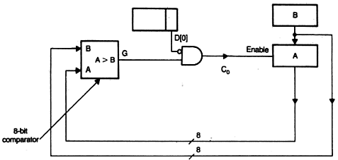
Basic Concepts (Contd..)
Normally two i/ps are associated with each reg:
E i/p or control i/p
Data i/p
The E i/p controls the data flow from A to B.
Reg B is loaded with A only when E is held high else contents of reg remain the same.
Such conditional transfer is expressed as
E: B←A
4. Control i/p can be a fn of more than a variable.
IF A>B and D[0]=0 then A←B

Slide 6
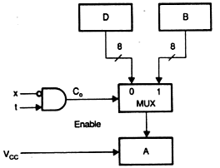
Basic Concepts (Contd..)
5. To perform reg transfer operation that involves selection.
If x=0 and t=1, then A←B
else A←D
Such transfer is expressed as
C₀ : A←B
C₀ ‘ : A←D
Where C₀ = x’t and
C₀ ‘ = (x’t)’ = x + t’
MUX selects reg B if C₀ = 1; otherwise reg D is selected.

Slide 7
Basic Concepts (Contd..)
The other reg transfer operations are
D←A’; Transfer the compl of A to D.
A← A+1; Increment the content of A by 1.
A← A-1; Decrement the content of A by 1.
D← AVB; A OR B, store result in D
D← AɅB; A AND B, store result in D
LSR(A); Logical shift right
ASR(A);
LSL, ASL, ROR, ROL
A$Q – used to concatenate A and Q
ASR(A$Q)

Slide 8
Basic Concepts (Contd..)
Whenever RWM is a part of processing section , MBR and MAR are associated with RWM unit.
MAR holds the address of desired mem word and MBR as buffer reg in all data transfer operations.
R: MBR← M((MAR))
W: M((MAR))← MBR
The line b/n RWM and MBR is bidirectional bus and it can be easily implemented using tristate buffers.
R(Read)
MAR
RWM
W(Write)
MBR

Slide 9
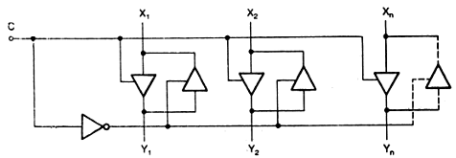
Basic Concepts (Contd..)
Fig: Bidirectional Data bus
When C=1, X to Y
When C=0, Y to X
6. i) Declare buses Inbus[4] and outbus[4] -- 4 bit buses
ii) A=inbus
means data of inbus is transferred to Reg A when next clock arrives
iii) Outbus = B[7:4]
Higher order 4 bits of 8 bit register B is made available on the outbus for one clock period.
Rate at which computer performs operations (such as A← A+M, A←AɅB ) is determined by bus structure.

Slide 10
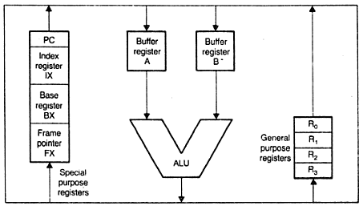
Buses:
Several types of bus structure within the CPU:
Single-bus oriented ALU
Two-bus oriented ALU
Three-bus oriented ALU
Single-bus oriented ALU

Slide 11
Single-bus oriented ALU (Contd..)
….
Disadvantages:
Affects speed of execution of a typical 2 operand memory
Each step given above increases the number of states in control logic. Hence more HW may be required to design control unit

Slide 12
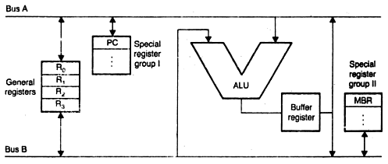
Two-bus oriented ALU

Slide 13
Two-bus oriented ALU (Contd..)
Output Buffer register is used to prevent collision of the buses
1st cycle: loading operands and storing result in O/P buffer
2nd cycle: result in O/P buffer is pushed to bus(destination). The contents of buffer reg can be gated to either bus A or bus B.

Slide 14
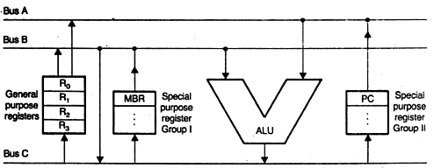
Three-bus oriented ALU

Slide 15
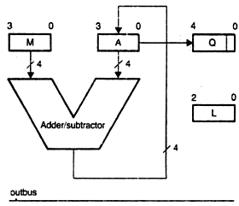
4 X 4 two’s complement Booth’s multiplier
(Refiquzamman)

Slide 16
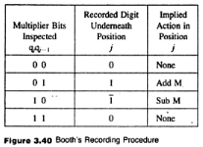
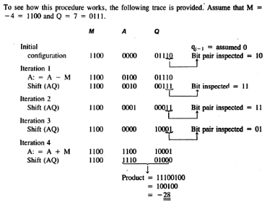

Slide 17
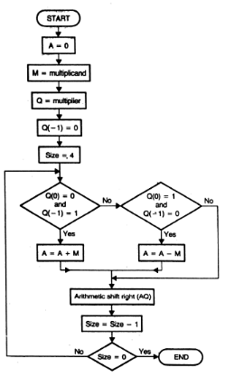
4 X 4 two’s complement Booth’s multiplier (Contd..)

Slide 18
HARDWIRED APPROACH
Control logic is a clocked sequential ckt.
So conventional sequential ckt design procedure can be applied to build CU.
Final circuit is obtained by physically connecting gates and flip flops.
Cost of control logic increases with system complexity.

Slide 19
10 steps for hardwired control
Define task to be performed.
Propose a trial processing section.
Provide a reg tx descr algo based on processing section outlined.
Validate the algo by using trial data.
Describe the basic char of the HW elements to be used in the processing section.
Complete the design of the processing section by establishing necessary control points.
Propose the block diagram of the controller.
Specify state diagram of controller.
Specify the char of the HW elements to be used in the controller.
Complete the controller design and draw a logic diagram of final circuit.

Slide 20
Step 1: Task definition.
Design a Booth’s multiplier to multiply two 4-bit signed numbers.
Step 2: trial processing section.
q₁ q₀
0 0→none
0 1→ add M
1 0→sub M
1 1→ None
Inbus

Slide 21
Step 3: register transfer description of Booth’s multiplier procedure based on the processing section outlined in the previous step.
Declare registers A[4], M[4], Q[5], L[3]
Declare buses Inbus[4], outbus[4]
Start: A←0, M←inbus, L←4; clear A and transfer M
Q[4:1]←inbus, Q[0]←0; transfer Q
Loop: if Q[1:0]= 01, then go to ADD
if Q[1:0]=10, then go to SUB;
go to Rshift;
ADD: A←A+M;
goto Rshift;
SUB: A←A-M;
Rshift: ASR(AQ), L←L-1;
if L>0, then go to loop
outbus =A;
outbus=Q[4:1];
go to halt

Slide 22
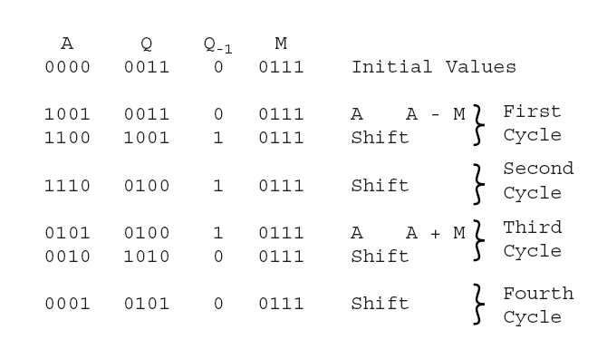
Step 4: Validate the algo by using trial data.

Slide 23
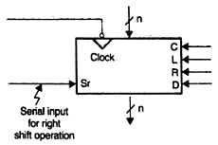

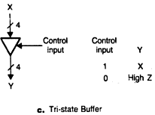
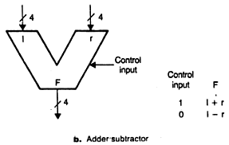
Step 5: Processing section includes GPRs, 4-bit adder / subtractor, Tristate buffers

